Slide 1
Privacy and Personal Data
11-10-2024 Willemijn Plomp & Jaap-Willem Mink
Based on “Practical application of the GDPR in a research setting” by Armin Halilovic, 2023 & “Introduction to Privacy” by Max van Arnhem, 2024 & https://www.uu.nl/en/research/research-data-management/workshops/privacy-basics-online-training & https://danstraining.moodlecloud.com/course/view.php?id=7
Notes:
W: 3,4,8,9,12,13,14,18,19,20,24,25,26,30,31,33,34
JW: 1,2,5,6,7,10,11,15,16,17,21,22,23,27,28,29

Slide 2
Overview
Personal data
Privacy and the GDPR
Privacy form (DPIA)
Privacy measures
Data breaches
Data sharing agreements/consortium agreements
MRI data
Who to contact?
Questions? privacy@fsw.leidenuniv.nl

Slide 3
1. Personal data
Personal data is any information that can be used to directly or indirectly identify an individual.
E.g., age, sex, length, address, BSN, medical diagnosis, job occupation
Exceptions: the dead, public information, the incredibly difficult to find
Be mindful of the ‘Mosaic Effect’: while individual pieces of data may not be able to identify someone, the combination of them might. For example, a combination of zip code, birth date, and sex can already tell a lot about a person.

Slide 4
Personal data
Personal data is basically any information about a person
But that’s not a problem! (usually)
When can you process personal data:
1: If you have a legal ground to do so (consent or public interest)
2: If you don’t use more data than you need for your goal.
3: If you are transparent about it (to participants and the University)
4: If you treat it securely

Slide 5
1. Personal data
Sensitive/special category personal data =
Racial and ethnic origin
Political opinions
Religious and philosophical beliefs
Trade union membership
Sex life and sexual orientation
Genetic data or biometric data uniquely identifying someone
Physical or mental health conditions
May harm your participants* (reputationally, legally, put them in danger)
Take extra security measures
*Now or in the future (e.g., abortion data, LGBTQ+ acceptance)

Slide 6
1. Personal data
Question: Dentistry student John studies the effects of organic toothpaste on dental plaque on a set of his patients by measuring which toothpaste the patients use, and how much dental plaque they have. What type of data would John most likely use?
Non-personal data
Personal data
Sensitive personal data

Slide 7
1. Personal data
Question: Dentistry student John studies the effects of organic toothpaste on dental plaque on a set of his patients by measuring which toothpaste the patients use, and how much dental plaque they have. What type of data would John most likely use?
Non-personal data
Personal data
Sensitive personal data

Slide 8
1. Personal data
Question: PhD candidate Mindy has written a scholarly article on the effects of car free zones on the traffic safety, comparing the number of traffic incidents between different Dutch municipalities. Which type of data would Mindy most likely use?
Non-personal data
Personal data
Sensitive personal data

Slide 9
1. Personal data
Question: PhD candidate Mindy has written a scholarly article on the effects of car free zones on the traffic safety, comparing the number of traffic incidents between different Dutch municipalities. Which type of data would Mindy most likely use?
Non-personal data
Personal data
Sensitive personal data

Slide 10
2. Privacy and the GDPR
Privacy is a human right:
The right to one’s own mind.
The right to be left alone.
The flow of information from and about you.

Slide 11
2. Privacy and the GDPR
The GDPR is a law at the European level.
General Data Protection Regulation
Goals:
  Enhance individuals' control and rights over their personal information
  To facilitate data sharing
11

Slide 12
2. Privacy and the GDPR
Principles of the GDPR
Lawfulness = Have a legal basis to process personal data (e.g., informed consent, public interest), be transparent towards participants, and process data fairly.
Purpose limitation = Specify why you process personal data from the start, and only use the data for that specific purpose.
Data minimization = Collect only the personal data you need for the stated processing purpose.
Accuracy = Take reasonable steps to ensure the collected data is accurate and up to date.
Storage limitation = Do not keep data for longer than necessary. (usually 10 years)
Integrity and confidentiality = Put in place appropriate measures to ensure the protection of personal data.
Accountability = The university needs to demonstrate how its data handling is compliant with the GDPR. (Informed consent forms, DPIA, DMP)

Slide 13
2. Privacy and the GDPR
Question: During COVID, restaurants needed to record customers’ contact details for potential contact tracing. Some of these restaurants used these contact details to send marketing messages.
Which GDPR principle is this a violation of?
Purpose limitation
Accountability
Accuracy

Slide 14
2. Privacy and the GDPR
Question: During COVID, restaurants needed to record customers’ contact details for potential contact tracing. Some of these restaurants used these contact details to send marketing messages.
Which GDPR principle is this a violation of?
Purpose limitation
Accountability
Accuracy

Slide 15
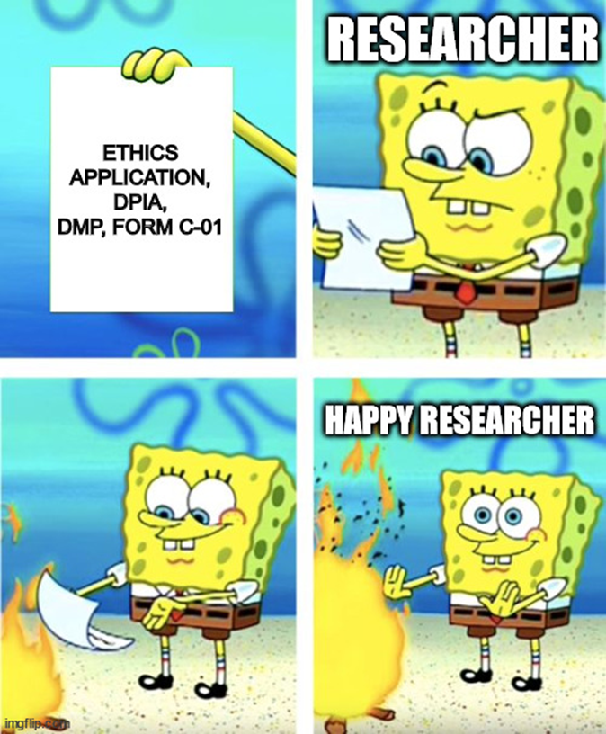
3. Privacy form (DPIA)
'Data Protection Impact Assessment'
Helps you assess the privacy risks
Makes you think about taking precautions to mitigate these risks at an early stage
Shows that you and the university are taking their participants' privacy seriously ("Accountability")
Download template

Slide 16
3. Privacy form (DPIA)
When do you need to write a DPIA?
When your study is “high risk”, e.g., a combination of factors like:
  You are using sensitive personal data (health, psychiatric diagnoses, drug use)
  You are studying vulnerable groups (children, patients)
  You are collecting large amounts of data
  Soon: short Pre-DPIA to check if you need a DPIA
  For now: check with us datastewards_psy_ped@fsw.leidenuniv.nl if you’re not sure.

Slide 17
3. Privacy form (DPIA)
Who will your participants be?
Which data will you collect? Is any of it sensitive?
What research methods will you use? Do you need any special services (e.g., a translator, unusual cloud storage)?
What is your legal ground for collecting personal data? (Usually informed consent or public interest)
Where will you store your data?
>>> How risky is your study & what measures will you take to mitigate those risks?
17

Slide 18
4. Privacy measures
Before research:
Talk to a privacy officer and/or write a DPIA
Make sure your participants are well informed about the purpose of the research and their risks before they sign their informed consent form.
Consent should be: Freely given, Specific, Informed, Unambiguous, Affirmative and Revocable
Don't collect more personal data than you need for the purpose of your research
Consider collecting less specific data, e.g. age instead of date of birth, province instead of city, salary range instead of exact salary
Adapted from: https://lcrdm.nl/wp-content/uploads/2023/03/LCRDM-How-to-treat-personal-data-in-research-0_1.pdf
18

Slide 19
4. Privacy measures
Before research:
Decide who needs access to the data and how long they need access
Plan to use a safe device and storage
  Use: university laptop, J-Drive, OneDrive, SurfDrive, ResearchDrive
  Don't use: personal computers, GoogleDrive, DropBox, Gmail
  Plan to use safe tools and software. Check with your privacy officer if you're unsure..
Adapted from: https://lcrdm.nl/wp-content/uploads/2023/03/LCRDM-How-to-treat-personal-data-in-research-0_1.pdf
19

Slide 20
4. Privacy measures
During research:
Pseudonymize your data (use a 'conversion key')
Store this key in a different (safe) place, with a unique (not your ULCN) password. Let at least two people have access.
(Alternatively, skip the conversion key and permanently anonymize your data. However, it's difficult to fully anonymize data. If even one participant is identifiable, your data is no longer anonymous. Even if data is anonymous now, it may no longer be anonymous in the future.)
Lock your computer when you leave the room
Keep any cabinets with personal data locked
Encrypt data if necessary (don't lose the password! Ensure at least two people know the password)
20

Slide 21
4. Privacy measures
After research:
Destroy the conversion key if you no longer need it (e.g., for follow-up research)
Don't keep the data longer than you promised the participants*
Don't use the data in different ways than you promised the participants*
Check if your data doesn't contain too much identifiable information before sharing
21

Slide 22
4. Privacy measures
Question: True or False? When I replace participants’ names with a code, the data are anonymous.
22

Slide 23
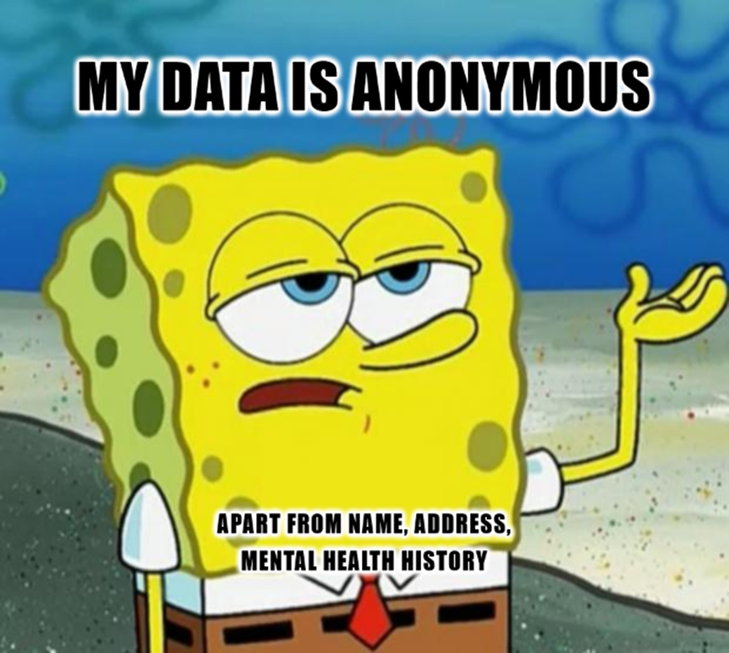
4. Privacy measures
False, Besides names, other variables in the dataset might still lead to direct identification of the participants. This is called pseudonymous data and is still considered personal data.
23

Slide 24
4. Privacy measures
In which of these cases is consent freely given?
A researcher asks in an online survey if the data subject approves of their data being used for academic research.
A professor asks his students to fill in a survey for his research, rewarding participating students with a higher grade for their exam.
24

Slide 25
4. Privacy measures
In which of these cases is consent freely given?
A researcher asks in an online survey if the data subject approves of their data being used for academic research.
A professor asks his students to fill in a survey for his research, rewarding participating students with a higher grade for their exam.
25

Slide 26
4. Privacy measures
Working with students:
Consider how much data they really need to access and for how long.
Discuss with them where they will store their data, e.g., only on the university network. Can they keep any data on personal devices?
Make sure they delete all data from personal devices when their thesis is done.
When working with sensitive audio or video data, consider asking them to only work at the university or to wear headphones and only work in a private area (i.e., not in a café, not in a student common room).
Discuss which tools are safe to use for personal data. Warn them not to enter personal data into ChatGPT.
Soon: Guidelines for students working with sensitive personal data
26

Slide 27

5. Data breaches
Data breach: Any unauthorized or illegal transfer, or acquisition of personal data.
  Lost USB-stick
  Stolen laptop
  Unauthorised transfer to external party or company
  Email sent to wrong address
  Report data breaches to the ISSC - 527 8888

Slide 28
6. Data sharing agreements/consortium agreements
Do you want to:
Work together with a different organisation while using personal data?
Reuse someone else's data?
Let someone else reuse your data?
Take your data with you to a non-EU country
Use a service to process your data (e.g., using translation software, hiring a company to transcribe your interviews, hiring a company to destroy our sensitive paperwork)
>>> You need a legal agreement that stipulates things like how the data will (not) be used, for what purpose, how long they can store it and how they will protect it.
28

Slide 29
6. Data sharing agreements/consortium agreements
Basic rule: sharing personal data with external parties is not allowed (unless it's shared openly).
-This includes software platforms, apps, email apps
For example: Gmail, ChatGPT, WhatsApp
UL-supported software platforms & parties we have an agreement with are fine
For example: Outlook, most Microsoft apps, SURF apps
29

Slide 30
7. MRI data
Is MRI data considered personal data? Can I share MRI data?
https://zenodo.org/records/4740126 Brain MRI data sharing guide
Structural MRI data is considered personal, you could identify an individual by their brain scan.
Group-level MRI data is considered anonymous and not personal
30

Slide 31
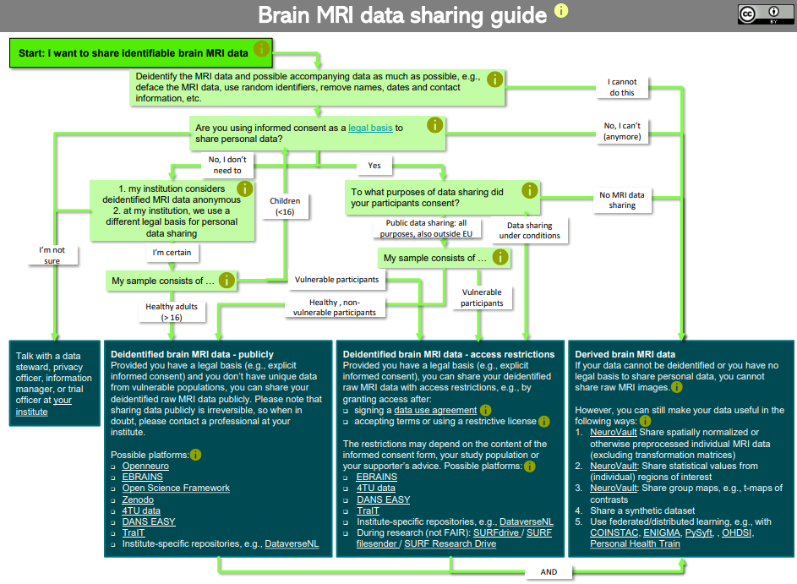

Slide 32
8. Who to contact?
To:
Review a DPIA
Set up a Data Sharing Agreement or other contracts
Ask if a certain service, device or software is considered safe
Ask any questions relating to privacy or personal data
>>> For at least the rest of 2024 contact the data stewards datastewards_psy_ped@fsw.leidenuniv.nl . We will help you or forward your case to the privacy officers.
We will let you know when this changes and you can directly contact the privacy office again.
32

Slide 33
The naughty researcher’s prayer:
“I don’t process personal data,
And if I do, it’s anonymous,
But if it isn’t, I encrypted it,
And if I didn’t, I deleted it,
And if I forgot, then it wasn’t personal data”
•Processing personal data is a normal part of research. Be transparent.
•Don’t obfuscate, or be hesitant to say you are processing personal data or if there are privacy risks involved. This will cost you more time and frustration.
33

Slide 34
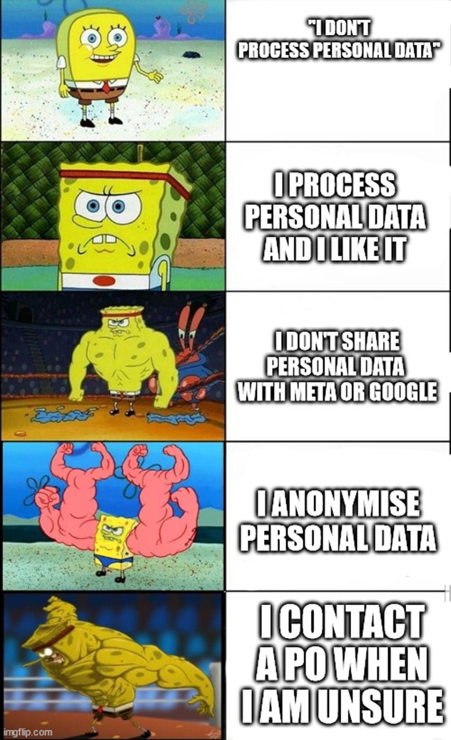
Thank you for listening!
Questions?
More information?
-Free, online training: https://www.uu.nl/en/research/research-data-management/workshops/privacy-basics-online-training

