Slide 1
The Tax System as a Complex Adaptive System
Prof. dr.ir. R. Arendsen October 26, 2016

Slide 2
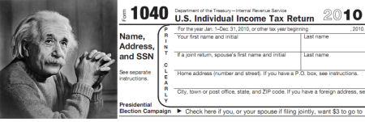
“The hardest thing in the world to understand is Income Taxes”
“This is a question too difficult for a mathematician.
It should be asked of a philosopher”.

Slide 3
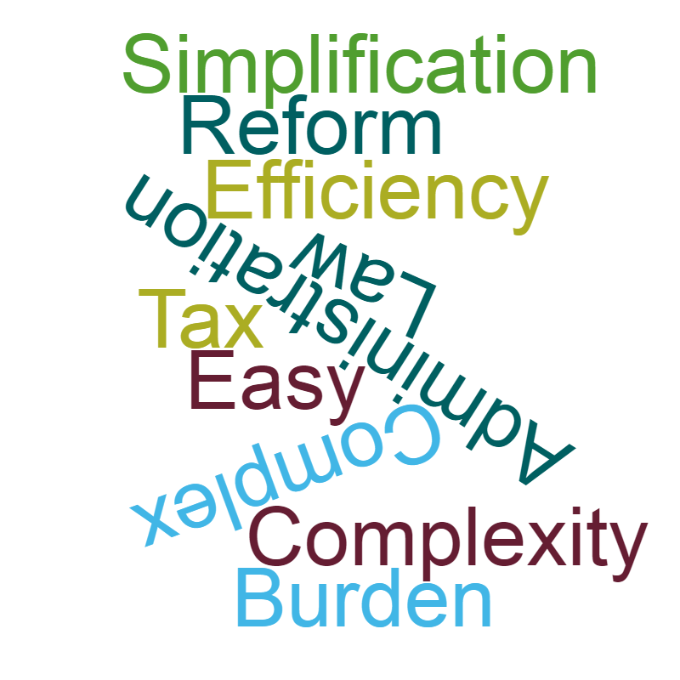
Tax Complexity?

Slide 4
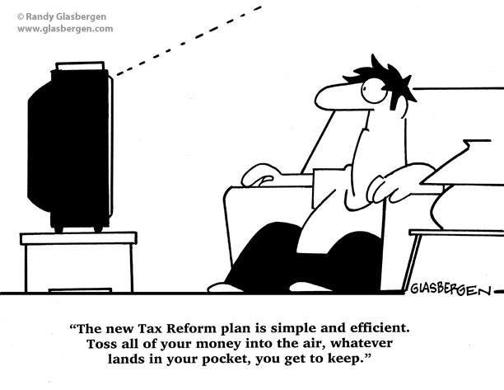

Slide 5
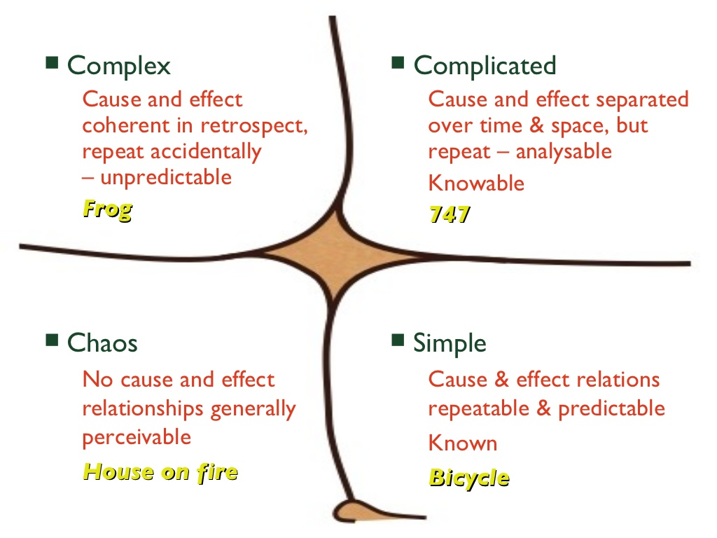
Complex vs. Complicated
The Cynefin Framework, David Snowden, Cognitive Edge

Slide 6
Complex Adaptive Systems
A collection of (many) interacting objects
Emergence: collective behaviour whose new properties transcend those of the consistuent components
Transitions: the (un)predictability of the change from one system state to the other
Resilience: what mechanisms suppport the system to react to external shocks or disruptions

Slide 7

Complexity Science (= Data Science?)

Slide 8
The Complex Tax System
Different aspects:
A legal system: laws and legal institutions
A financial system: money, flows and agents
An information system: data and message exchange and processing
Different theoretical perspectives:
Compliance (eg. regulatory capitalism)
Efficiency (eg. administrative burden)
Service provision (eg. dis-intermediation)

Slide 9
First Research Questions and Methodology
(how) can we define/model the tax system as a complex system?
emergence, transitions, resilience
(how) can we analyse systems behaviour?
building computational models
what is the actual systems behaviour?
understanding it?
predicting it?

Slide 10
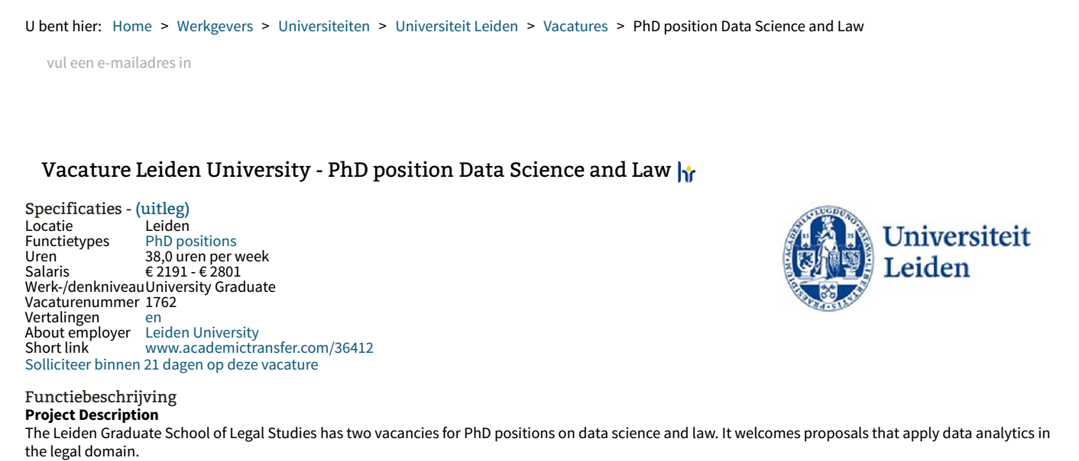
Advertorial

