Slide 1
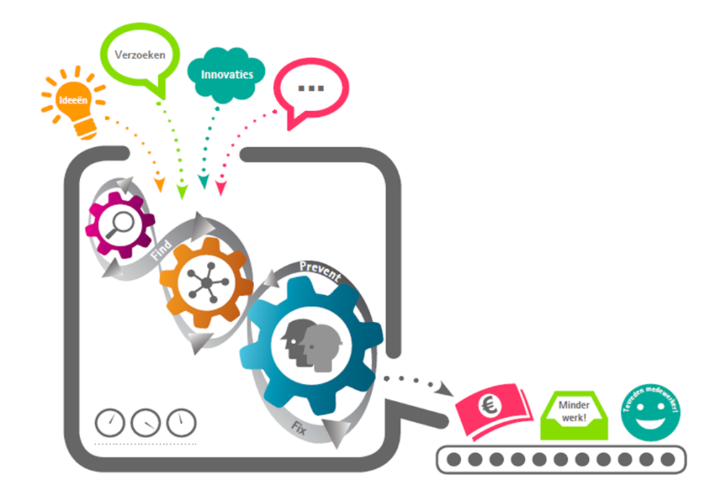
Applying Analytics for Improved Taxpayer Supervision
Mark Pijnenburg
Dutch Tax and Customs Administration
Leiden University
Wojtek Kowalczyk
Leiden University
LCDS meeting
26th October 2016
Notes:
Hi, welcome everybody. My name is Mark Pijnenburg.
Work part time -> bring problems to Leiden
Data science -> analytics in tax administration context
I’d like to tell you something about what to expect from Analytics within a tax administration context. To do so, I’d like to take you with me to the problem of the Dutch Tax Administration, that is, in fact, a problem for all tax administrations in Europe.

Slide 2
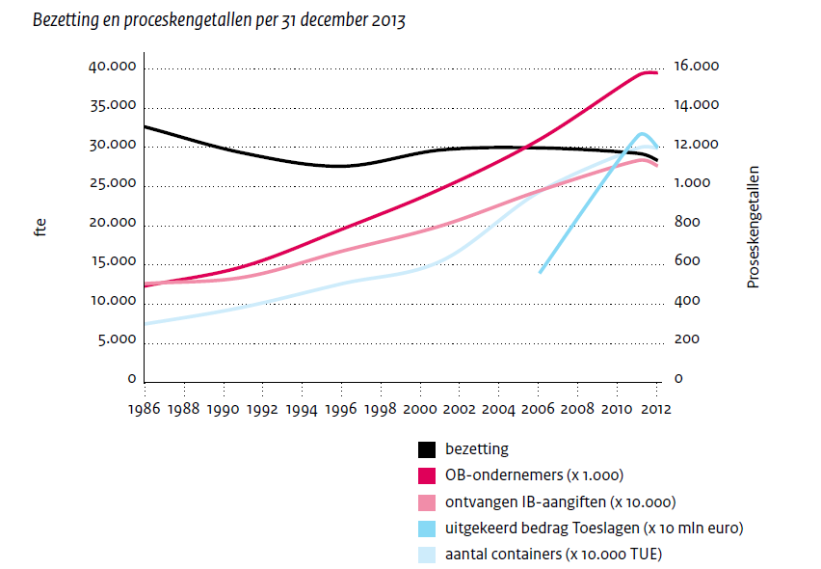



Problem
3 times
entrepreneurs
Trends that relate to workload
.
.
.
.
# employees
employees
entrepreneurs (x 1.000)
number of income tax returns (x 10.000)
amount of paid benefits (x € 10.000.000)
number of shipping containers (x 10.000 TUE)
Notes:
‘hand out’ benefits

Slide 3


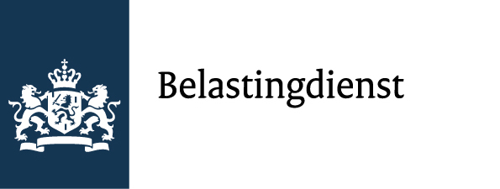

Budget Cuts
Supervision
Tax Administration
Demanding Citizens
More dynamic
Notes:
As a tax administration you have to do two things: 1. Make it possible for people to pay taxes, 2. Check whether everybody paid its taxes

Slide 4

Solution
?
Notes:
In the Netherlands, taks administration has access to many information. All is digital for years.

Slide 5

Our Journey
Theoretical
T-a-x-p-a-y-e-r
S-u-p-e-r-v-i-s-i-o-n
A-n-a-l-y-t-i-c-s
Practical
Risk Model BTW (VAT)
Notes:
Research Plan:
Decompose the term Analytics
Decompose the term Taxpayer Supervision
Match Analytical techniques to Taxpayer Supervision
4 practical examples
Discussion

Slide 6
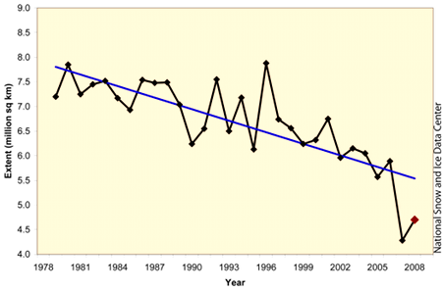
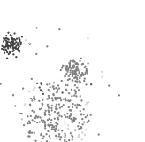

Analytics develops…
Descriptive Statistics
Hypothesis Testing
Experimental Design
Predictive Modelling
Time Series Analysis
Cluster Analysis
Anomaly Detection
Mining new Data Sources
Network Analysis
Techniques from Marketing
Notes:
See classical works on Analytics as Davenport, …

Slide 7

Taxpayer Supervision ― Limited Resources
1. risk identification
2. risk analysis
3. prioritization
Repres-sion
Pre-vention
4. treatment
5. evaluation
Notes:
Taxpayer supervision -> story of limited resources. Some of you might know, not capacity to check each and every-one.
So, activities within taxpayer supervision can best be understood by applying a framework that deals with scarce resources.
We used a five step framework that is know as the compliance risk management process within tax administrations.

Slide 8
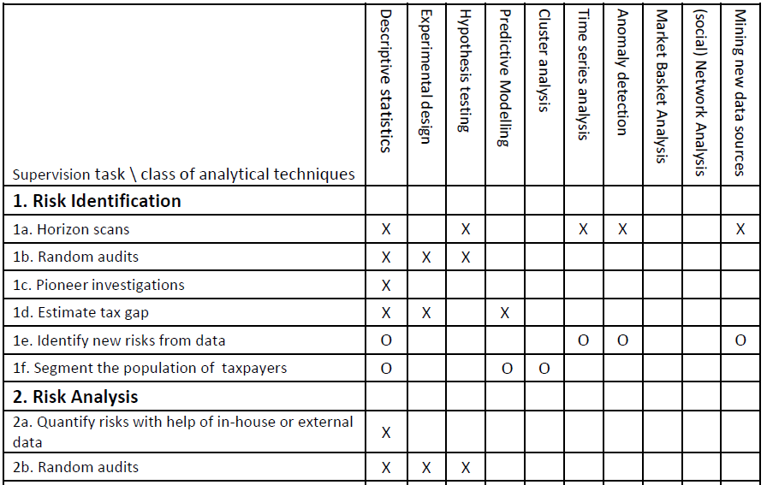

Linking
Some applications have to prove their value
50% activities can be supported:
Not only analytics
Analytics has impact
It is almost always a mix of expert knowledge and analytics

Slide 9

Value Delivered
Doubled
Effect
in numbers
Substantial
Improved Effect
Half value
Notes:
5 FTE in three years
Improvement is not caused by finding one big unknown predictor of errors, it is the effect of adding many small predictors in the right proportion

Slide 10

Roadmap to Analytics
4. Analytical
organizations
5. analytical competitors
Intuition
3. Analytical
aspirations
Vision, infrastructure, senior support, universities
Insights + embedded analytical processes
2. localized analytics
1. Analytically impaired
Davenport and Harris
Notes:
5 FTE in three years

Slide 11
Conclusions
Not fundamentally new, but more rational decisions can bring substantial improvements.
Insight by decomposition.
Half of supervision activities can be assisted with analytics.
Not all techniques have established their added value yet.
Watch out
What is not in, cannot get out.
Analytics might damage prevention.
No excessive checking of citizens.
Notes:
Established their added value: Meanwhile, caution should be taken not to neglect other proven approaches for improving taxpayer supervision, such as ‘compliance by design’.
2 examples
In the Netherlands, we find it an important principle to treat citizens as trustworty and with respect. For that reason, we do not want to excessively check whether they behave exactly according to the law. This leads to an important principle that we only use data if we have first defined the particular risk we are looking for, and that the data we couple is in proportion to the severity of the risk. For the Netherlands it is important to never loose sight of this important principle.

