Slide 1


Government finance statistics 2.0
Challenges for data scientists?
Notes:
Floris Jansen: Spokesman and researcher in Government Finance Statistics at Statistics Netherlands.
Not native. Please correct me or tell when not clear.
Answer to question: yes. (otherwise a very small presentation).
Short overview of Statistics Netherlands: Heerlen and Den Haag.
Independent statistics, describes society, ‘free’ for every one (or already paid for by taxation).
First a little bit more on government finance statistics

Slide 2
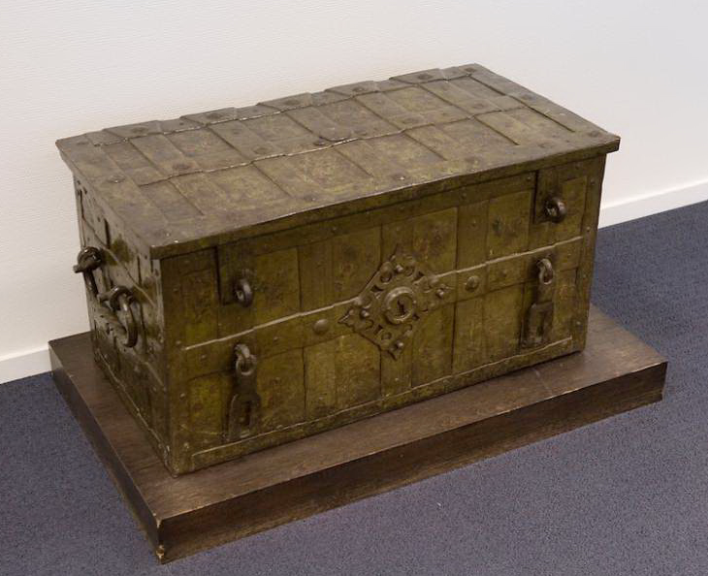
Government Finance Statistics 0.0
Notes:
One of the oldest statistics: count the coins in treasury chest. The emptier, the easier.
Gerrit Zalm always showed how empty the chest was.
Basically we make an annual report for Government.

Slide 3
Government Finance Statistics 1.0
Notes:
What is Government Finance Statistics nowadays? Key figures: Deficit, debt → excessive when above the norm of 3 and 60 percent.
Guess: are we within the norms?

Slide 4
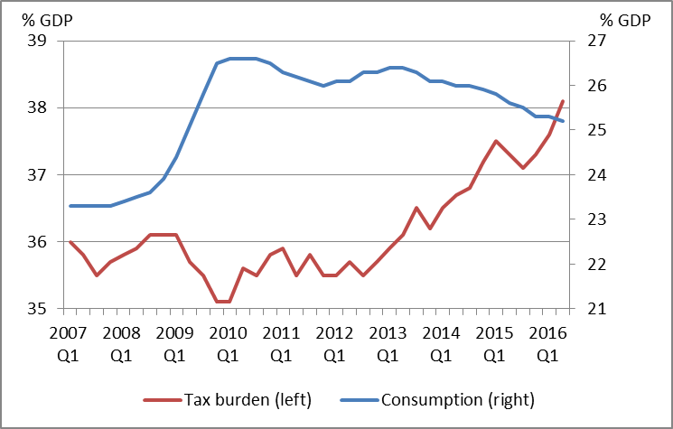
Government Finance Statistics 1.0
Notes:
These graphs are not very flashy, but they do work.
Tax burden to record level
Consumption increases: government’s share in economy increases. Largely because rest of economy decreases.

Slide 5
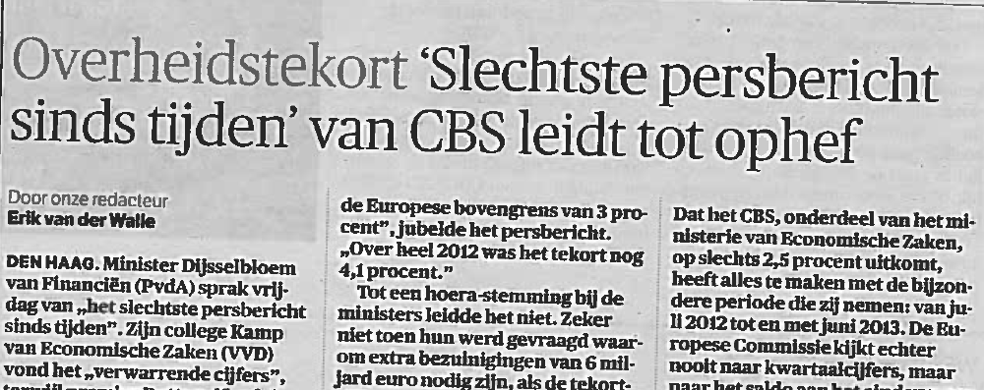
Relevant?
Notes:
Relevant? We like to think so!
Statistics Netherlands: we present facts, whether politicians like them or not.

Slide 6
Relevant?
22 oktober 2009:
“Eurostat has expressed a reservation on the data reported by Greece due to significant uncertainties over the figures notified by the Greek statistical authorities.”
Notes:
Case of Greece: this happens when statistics are made by politicians. Deficit increases with every revision
In our job, these reservations are very serious.

Slide 7
Relevant?
Notes:
Debt is revised upwards each time

Slide 8
What is government?
CAO-sector
Core Goverment
Public Governance
National Accounts
‘Wet Normering Topinkomens’
Notes:
First question is always a definition question: what is Government?
Many definitions. With many different outcomes
<Het gaat hier om het idee, ik weet niet precies hoe al die populaties er uitzien en dus overlappen of niet>

Slide 9

What is government?
National Accounts
Notes:
Our definition is that of the national accounts: ESA
The contrary to the European Space Agency, it is not rocket science.

Slide 10
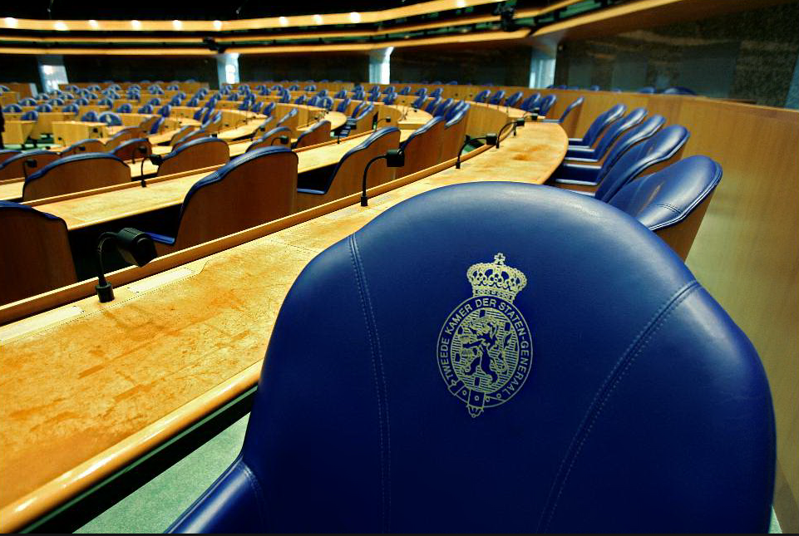





Government Finance Statistics 1.0
Notes:
What is government in national accounts? Ideas? How about parliament? University Leiden? Prorail (BV)? NS (NV)? ABN Amro?
Case of Prorail: first separation from NS, now a ‘ZBO’ → Guess effect on government finance statistics?

Slide 11
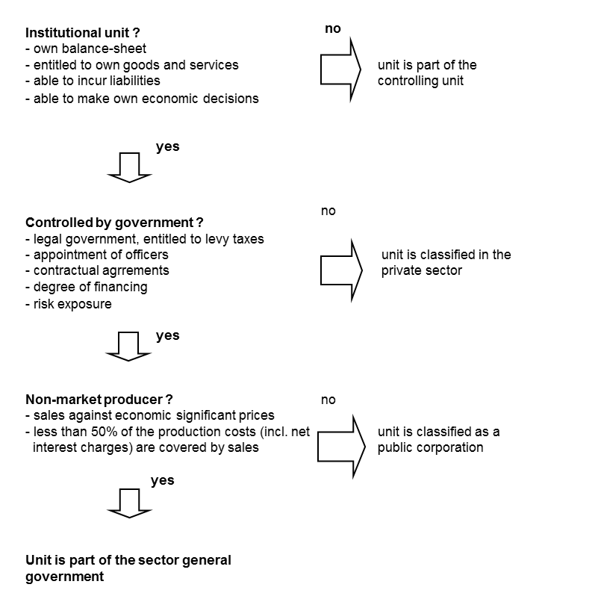
Delimitation sector general government decision tree
Notes:
For each unit we use this decision tree
Institutional units which are non-market producers and in government control:
Control: notice the apparent loop? Solve by first defining ‘Core Government’: All bodies that levy taxes and social contributions
Economically significant prices → 50 % rule
thousands very diverse units including non-profit institutions and non-market corporations

Slide 12
Case by case data collection 1.0
Cannot ask suppliers for sector classification
Documentation needed for decision tree:
(Depending on legal type)
Accounting reports
Annual reports
Statutes
Both unit and item nonresponse
Prioritize units: link to key figures
Notes:
Only structured documents. ESA demands stucture.
Lot of manual labour now for finding and interpreting annual reports.

Slide 13
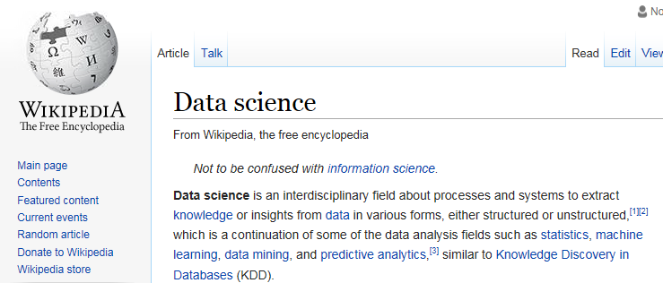
Government Finance Statistics 2.0
?
Notes:
What do we mean with GFS 2.0? Make GFS as a data scientist?
Not an expert on data science → WIKI
Not information science → an interdisciplinary field primarily concerned with the analysis, collection, classification, manipulation, storage, retrieval, movement, dissemination, and protection of information.
Sounds like my job!
Data science is structured or unstructured → Half a balance sheet? Tweets?→ Comply with ESA? Does not sound like my job! Should it be my job?
In this part of the presentation, I hope to be just as much a listener as a speaker.

Slide 14


Government Finance Statistics 2.0
Notes:
Should I be a data scientist? Harvard Business Review dubbing it "The Sexiest Job of the 21st Century”. Don’t feel sexy.
Google sexy scientist, this picture of Harrison Ford is the most presentable. Future of ‘robots’?

Slide 15

Government Finance Statistics 2.0
Find and interpret rich data sources
Manage large amounts of data
Merge data sources, ensure consistency of datasets.
Create visualizations to aid in understanding data
Present and communicate the data insights/findings
Produce answers in days rather than months
Work by exploratory analysis and rapid iteration
Produce and present results with dashboards (displays of current values) rather than papers/reports, as statisticians normally do
Notes:
Return to WIKI:
Find and interpret rich data sources → Okay, but new data sources means revisions! Motto of national accounts: “better to do wrong but consistent then good but inconsistent!”. Watson?
Manage large amounts of data → Okay. I guess our database is not small. But not huge either.
Merge data sources, ensure consistency of datasets → Merge or choose? We choose. Merging might enrich the dataset.
Create visualizations to aid in understanding data → Just beginning. Not yet that far!
Present and communicate the data insights/findings → Yes we can! Papers, vlogs, tweets, podcasts, professional spokesmen.
Produce answers in days rather than months → No, first figures at t+45 days. Definitive figures after two years.
Work by exploratory analysis and rapid iteration → No, we are accountants, not fortune tellers! Watson of IBM to interpret annual report and make the sector classification?
Produce and present results with dashboards (displays of current values) rather than papers/reports, as statisticians normally do → Do both? Dashboard are not that nuanced
No I am not a data scientist yet, half a data scientist at best…

Slide 16
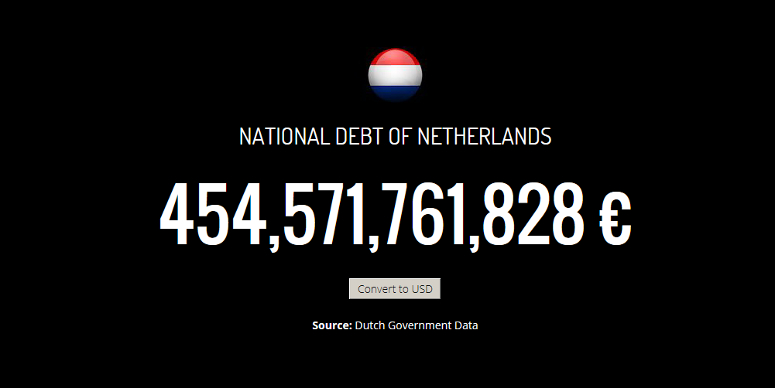
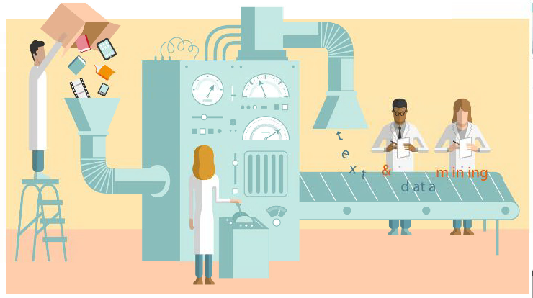
Government Finance Statistics 2.0
Notes:
Make GFS like a data scientist?
What can Statistics Netherlands learn from you?
New statistics? → Not bound by ESA? Effectiveness of government expenditure? Not our job to decide if money is well spend? Algemene Rekenkamer
Decision tree? Binary! → computer job!
Data collection? Or data mining? Shit in gold out? With some help of Watson
Open access output and input? → privacy?
Integration of datasets in national accounts? → prioritizing?
Visualisations? → Dash boards, maps, interactive tools (‘my personal tax meter’ → what do people from tax authority think of this?)
Now casting? → debt clock → real time deficit? Quote Nassim Nicholas Taleb: if you want to kill yourself, get a personal physician and constant measure your hearth beat. More data is more measure faults.

