Slide 1

Experience the master PHM
PHM Experience Day

Slide 2

Today’s programme
Get to know each other | 14:30 – 14:45
Alumni Q&A | 14:50 – 15:25
Get to know PHM | 15:30 – 16:00
Guest lecture | 16:10 – 16:30
Mini casestudy | 16:30 – 17:10
Ask us anything | 17:10 – 18:15
Notes:
Leonie explains the programme and introduces Madelaine.
Megan will be taking some pictures. Bij haar aangeven als ze hier problemen mee hebben
Guest lectures Panel Management Anne de Boer en APM Sander Steenhuis
Mini case study about lonely elderly. How to tackle this challenge with PHM?
Programma: PHM Experience Day - Leiden University

Slide 3

But first, get to know each other!
Notes:
Veerle:
- Who joined the master open day in February?
- Who did a bachelor in Medicine?
- What are you expectations of PHM?
- What other bachelors do we have in the room?

Slide 4

New Challenge
Population Health Management

Slide 5
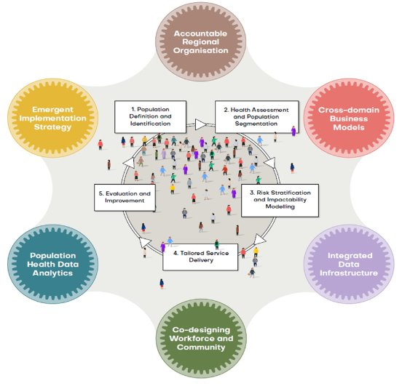
PHM : HEALTH FIRST
A Population approach
Health First
Societal Value
Academic Trusted Partner
Policy
Practice
Science
Strategic, Tactical and Practical

Slide 6
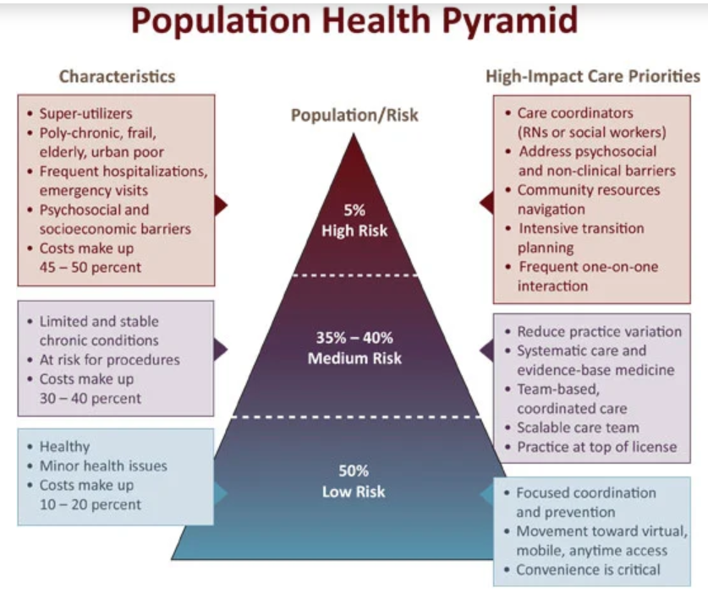

Difference to Public Health and Clinical Services

Slide 7

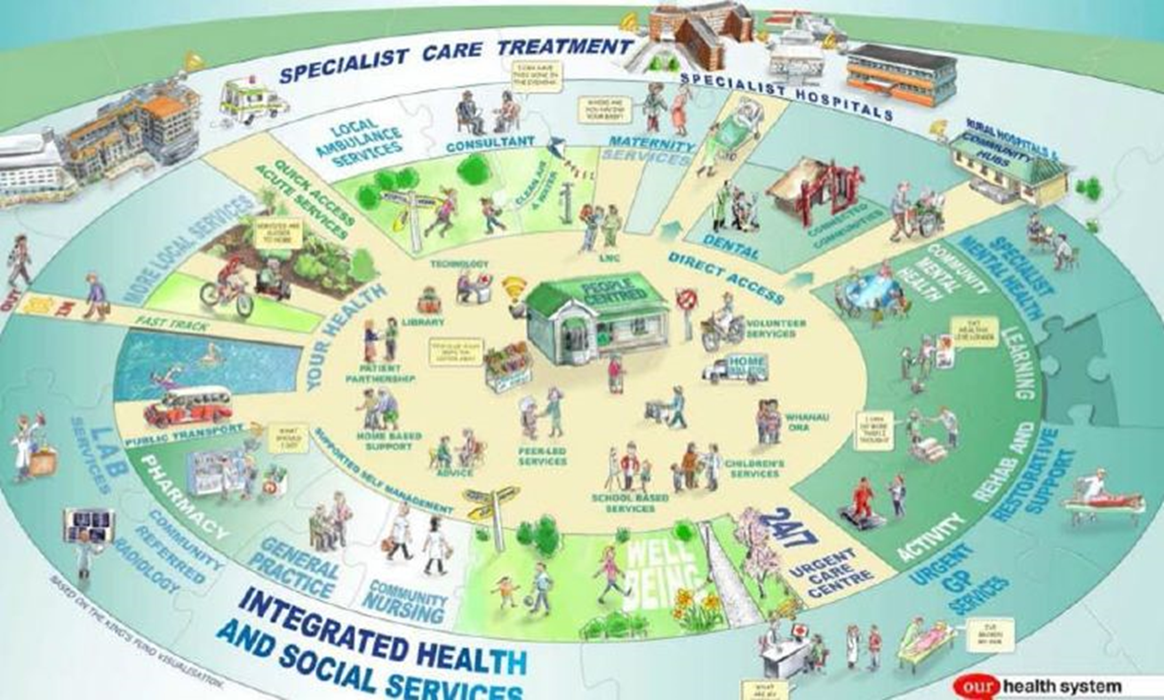

Difference to Health Care Management

Slide 8
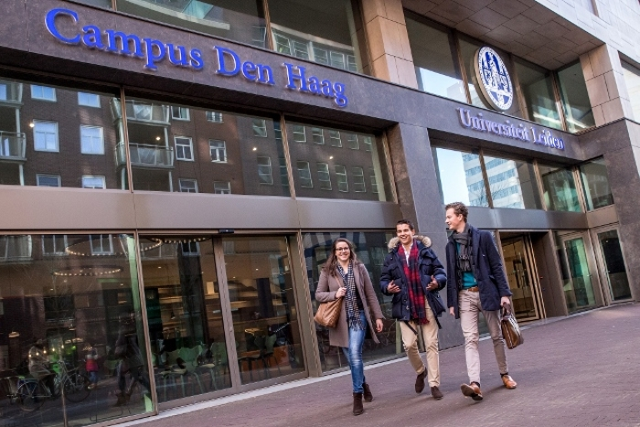

Step into PHM in The Hague and Abroad
Disciplinary Focus
Medicine
Behaviour
Data
Interdisciplinary Focus
Syndemics
Alternative Payment Models
Predictive Analytics
Implementation
Free space
Governance
Internships
Electives
Panelmanagement
Thesis
Individual PHM area
All over the world
Solid 1st year
Choose your individual Focus
Year 2

Slide 9
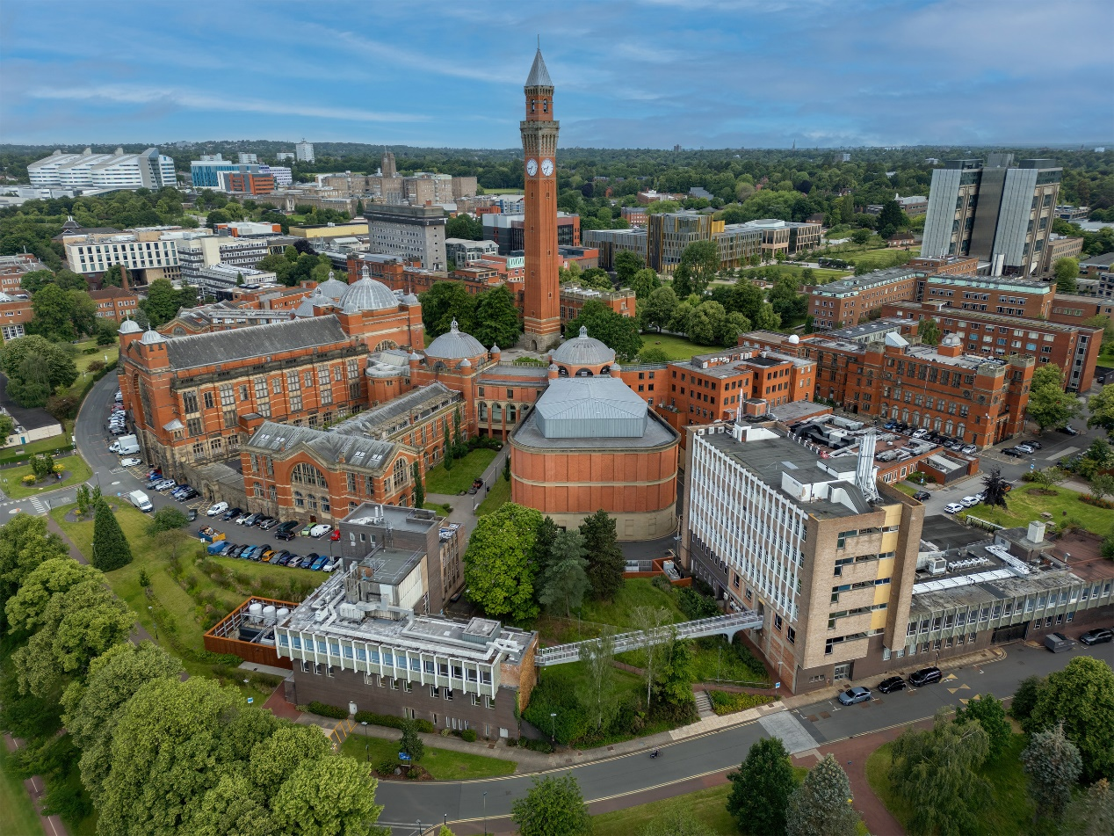

Combined programme with the University of Birmingham

Slide 10
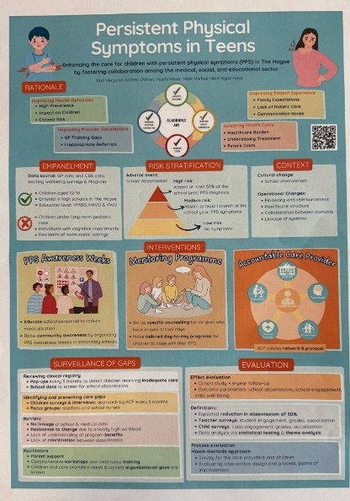
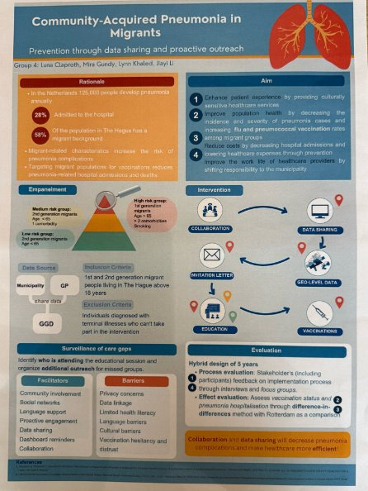
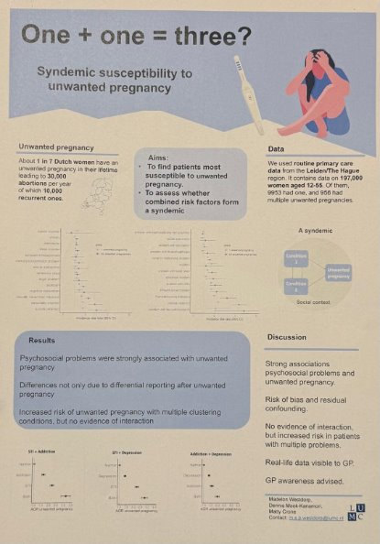
Student products

Slide 11

Admission requirements
Directly admissible:
Or sufficient knowledge on medicine and quantitative methods
Online bridging programmes available
All info can be found on our website
Medicine
Biomedical Sciences
Clinical Technology
Bio-Pharmaceutical Sciences
Pharmacy
Human Nutrition
Health Sciences
Veterinary
Health and Society
European Public Health
Medical Natural Sciences
Notes:
Laten zien als er vragen over zijn vanuit de zaal

Slide 12



What’s Next?
Apply via our website!
Want to study PHM in September?
More questions?
About the programme: 📧 studyadvisorPHM@lumc.nl
Chat with our students during the drinks and bites
Or Daniel Picado via Unibuddy
Stay connected!
@populationhealthmanagementlumc
Master Population Health Management
We’d love
your feedback

Slide 13


