Slide 1
PHM Syndemics
Evelien Dubbeldeman & Yassir Gnaoui

Slide 2
History of syndemics
Singer (1996) studying HIV epidemic in Puerto Rican community in Hartford US
Notes:
Greek word synergos, meaning two or more agents working together to create a greater effect than the sum of each working alone = the essence of a syndemic. The second is demic, a verbal suffix derived from the Greek word demos, or “ people.

Slide 3
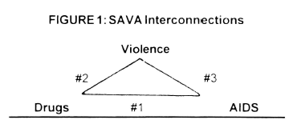
Coined a syndemic
Substance Abuse
Violence
HIV-AIDS
Concentrated in US urban inner cities
>> the SAVA syndemic
Singer (1996)
Notes:
Greek word synergos, meaning two or more agents working together to create a greater effect than the sum of each working alone = the essence of a syndemic. The second is demic, a verbal suffix derived from the Greek word demos, or “ people.

Slide 4
Syndemic criteria
Disease A
Disease B
Synergy
1. Clustering
More than the sum of the individual parts
Disease A
Disease B
Disease burden
2. Interaction
Disease A
Disease B
3. Context

Slide 5
1. Two or more diseases cluster together in time or space.
Disease A
Disease B
Example: Social Distress, Depression, and Diabetes syndemic among Mexican Immigrant women in the USA (Mendenhall, 2012)

Slide 6
2. These diseases interact in meaningful ways, whether social, psychological, or biological.
Disease A
Disease B
Examples of disease-disease interaction: Depression and diabetes, effects of depression on mood and decreased physical activity support the development of diabetes
Enhanced contagiousness → one disease promotes the contagiousness of another disease syphilis and HIV, genital tract ulceration produced by syphilis support sexual transmission of HIV

Slide 7
3. Harmful social conditions drive these interactions.
Disease A
Disease B
Example: Structural racism delays care-seeking, lack of infrastructure.

Slide 8
PHM Syndemics
Online
Online
On Campus
Individual
4 weeks
Notes:
M1: In the first module you will start with learning more about syndemics and understanding the concept of syndemics and how it was developed. M2: In the second module you will learn about how to assess whether health conditions cluster and interact in a population.
>> Quantitative
M3: The third module introduces you to qualitative research. Qualitative methods will help you understand the social and contextual conditions that shape these clusters and interactions.
M4: In the last module you will learn how to combine quantitative, qualitative into a mixed-method approach.

Slide 9
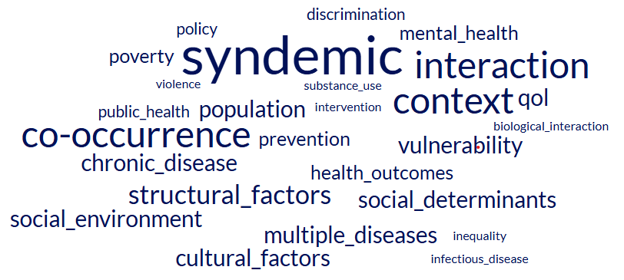

PHM Syndemics – Online weeks
4 modules
Notes:
M1: In the first module you will start with learning more about syndemics and understanding the concept of syndemics and how it was developed. M2: The second module has a quantitative focus where you will dive into routinely collected data from General Practitioners and SN and use statistical programs such as R studio and SPSS to explore whether health conditions cluster and interact within a population.
M3: The third module introduces you to qualitative research. Qualitative methods will help you understand the social and contextual conditions that shape these clusters and interactions.
M4: In the last module you will learn how to combine quantitative, qualitative into a mixed-method approach.

Slide 10
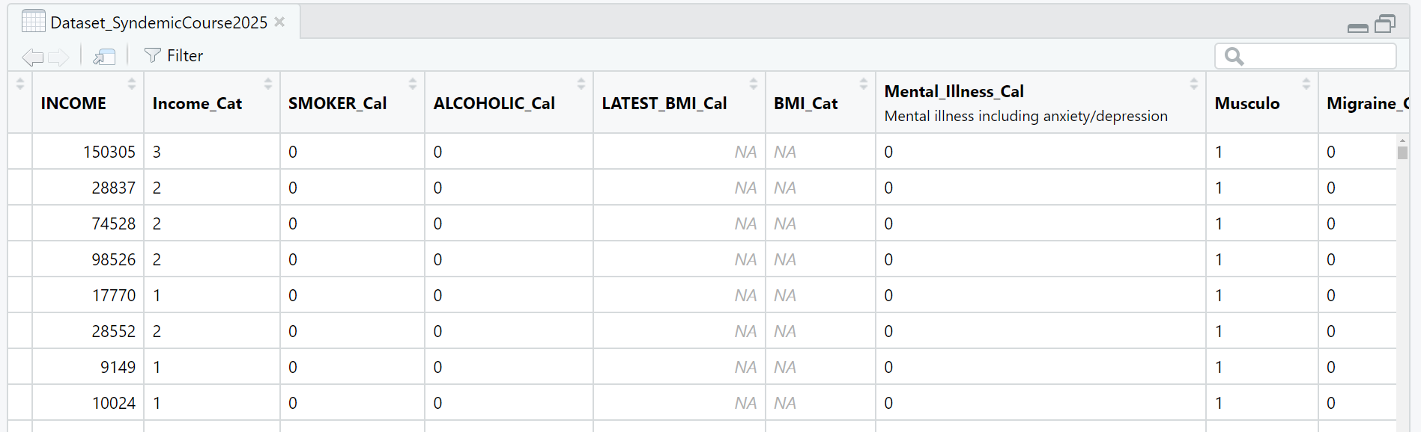

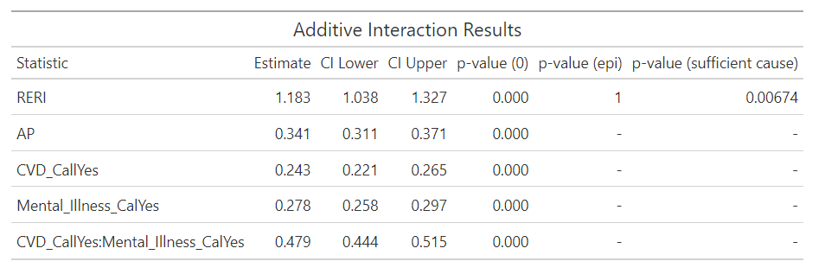
PHM Syndemics – Online weeks
4 modules
Notes:
M1: In the first module you will start with learning more about syndemics and understanding the concept of syndemics and how it was developed. M2: The second module has a quantitative focus where you will dive into routinely collected data from General Practitioners and SN and use statistical programs such as R studio and SPSS to explore whether health conditions cluster and interact within a population.
M3: The third module introduces you to qualitative research. Qualitative methods will help you understand the social and contextual conditions that shape these clusters and interactions.
M4: In the last module you will learn how to combine quantitative, qualitative into a mixed-method approach.

Slide 11


PHM Syndemics – Online weeks
4 modules
Notes:
M1: In the first module you will start with learning more about syndemics and understanding the concept of syndemics and how it was developed. M2: The second module has a quantitative focus where you will dive into routinely collected data from General Practitioners and SN and use statistical programs such as R studio and SPSS to explore whether health conditions cluster and interact within a population.
M3: The third module introduces you to qualitative research. Qualitative methods will help you understand the social and contextual conditions that shape these clusters and interactions.
M4: In the last module you will learn how to combine quantitative, qualitative into a mixed-method approach.

Slide 12


PHM Syndemics – Online weeks
4 modules
What
Quantitative
Why
Qualitative
Relationships
Context
Clustering
Reasons for behavior
Interaction
Explanations
Prevalences
Experiences
Notes:
M1: In the first module you will start with learning more about syndemics and understanding the concept of syndemics and how it was developed. M2: The second module has a quantitative focus where you will dive into routinely collected data from General Practitioners and SN and use statistical programs such as R studio and SPSS to explore whether health conditions cluster and interact within a population.
M3: The third module introduces you to qualitative research. Qualitative methods will help you understand the social and contextual conditions that shape these clusters and interactions.
M4: In the last module you will learn how to combine quantitative, qualitative into a mixed-method approach.

Slide 13
PHM Syndemics – Online weeks
Introduction:
What is a
Syndemic?
Quantitative:
Clustering
& Interaction
Qualitative:
Understand social
&
contextual factors
Mixed methods:
Combine quantitative
&
Qualitative methods
Results used in On Campus weeks

Slide 14
PHM Syndemics – On Campus week
Based on quantitative results from online weeks >>> Mixed Methods
Qualitative data - Interviews
Mixed methods
Combining quantitave and qualitative methods
Utilize the strenghts of both methods
Challenges researchers to adopt different perspectives
Challenging, but rewarding experience!

Slide 15

PHM Syndemics – Individual week
Notes:
The individual week focuses on the final assignment, which will be a fun and truly unique one: namely, creating your own podcast. In this podcast, you’ll dive into the results of your research conducted during the online and on campus weeks, explore what they mean for practice and policy, and learn how to convincingly present your own insights to the public.

Slide 16
PHM Syndemics
“From data to the streets:
explore syndemics through numbers, stories, and lived realities.”

